Slide 1
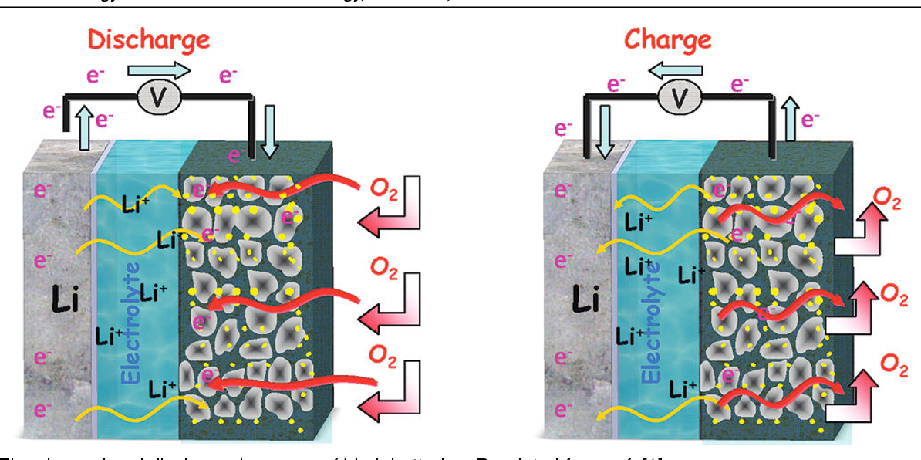
Li-air batteries
https://www.youtube.com/watch?v=8pMFLpiqPAc

Slide 2
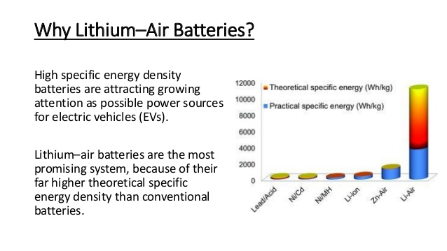
Li-air batteries

Slide 3
Li-air batteries

Slide 4
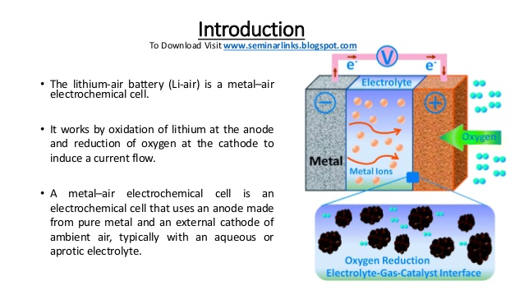
Li-air batteries: introduction

Slide 5
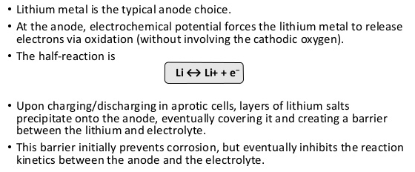
Anode material

Slide 6
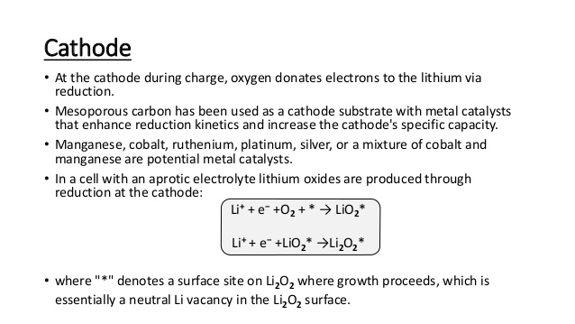
Cathode material/reactions

Slide 7
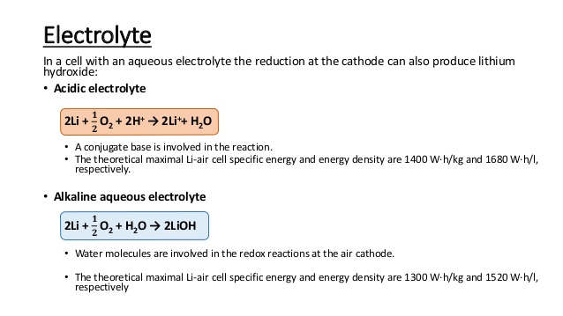
Electrolyte

Slide 8
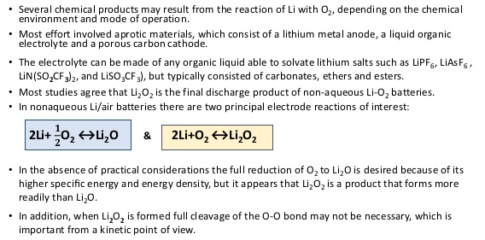
Aprotic(non aqueous)Li-air batteries

Slide 9
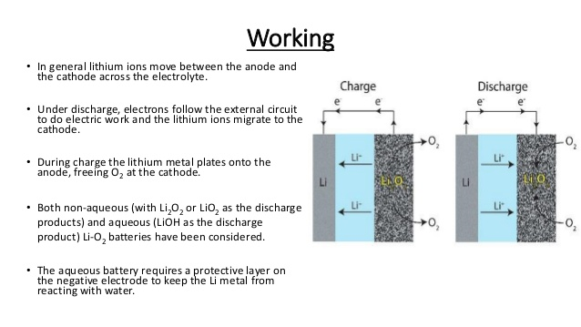
Working

